Slide 1
Sudoku Solver Visualizer
An Interactive Approach to Understanding Brute Force Algorithm in Sudoku Solving
PRESENTED BY:
NAMAN SINGH

Slide 2
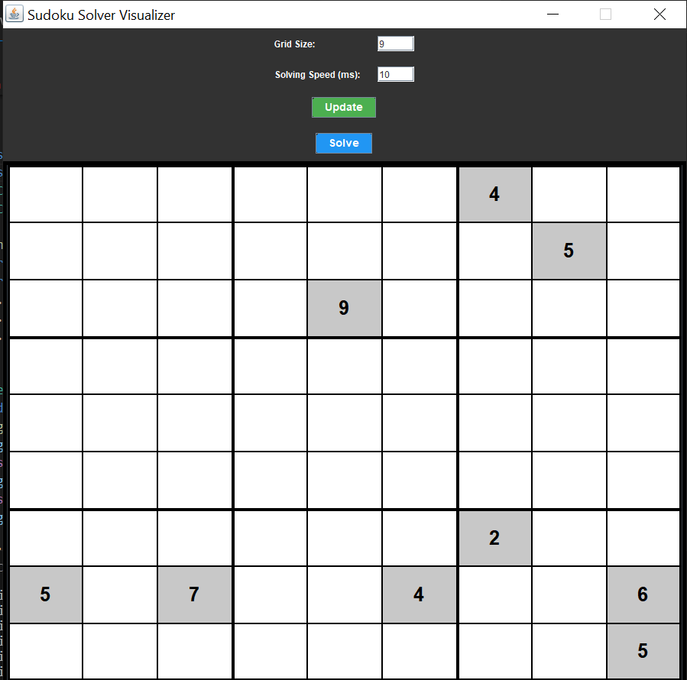
What is Sudoku?
Sudoku is a popular number puzzle game . The objective is to fill a 9x9 grid with digits so that each column, each row, and each of the nine 3x3 grids contain all of the digits from 1 to 9.Brief history and origin of Sudoku.

Slide 3
Sudoku Rules
Each row must contain the digits 1-9 without repetition. Each column must contain the digits 1-9 without repetition. Each 3x3 sub-grid must contain the digits 1-9 without repetition. Discuss common techniques used by players to solve Sudoku puzzles.

Slide 4
What is the Brute Force Method?
Brute force is a straightforward problem-solving technique that involves trying all possible solutions until the correct one is found.
It is often used when the problem space is small or when more sophisticated algorithms are unavailable or unnecessary.
Brute force algorithms are generally simple to implement but can be inefficient, as they may require a large number of attempts.

Slide 5
Brute Force Algorithm Steps
Find an empty cell.
Place a number from 1 to 9 in the cell.
Check if the number is valid (does not violate Sudoku rules).
If valid, repeat the process for the next empty cell.
If invalid, backtrack and try the next number.
Continue until the puzzle is solved or all possibilities are exhausted.

Slide 6
Customization Options
Difficulty Level
Puzzle Types
Solving Techniques
Interface Change
Progress Tracking

Slide 7
Conclusion and Future Aspects
The Sudoku Solver Visualizer is a powerful tool that not only solves complex puzzles but also provides an engaging and educational experience for users. As the application continues to evolve, we plan to introduce new features and enhancements, such as multiplayer modes, adaptive difficulty settings, and integration with social platforms to foster a thriving Sudoku community.

